Slide 1
Maryland Public Service Commission
The mission of the Maryland Public Service Commission is to ensure safe, reliable, and economic public utility and transportation service to the citizens of Maryland

Slide 2
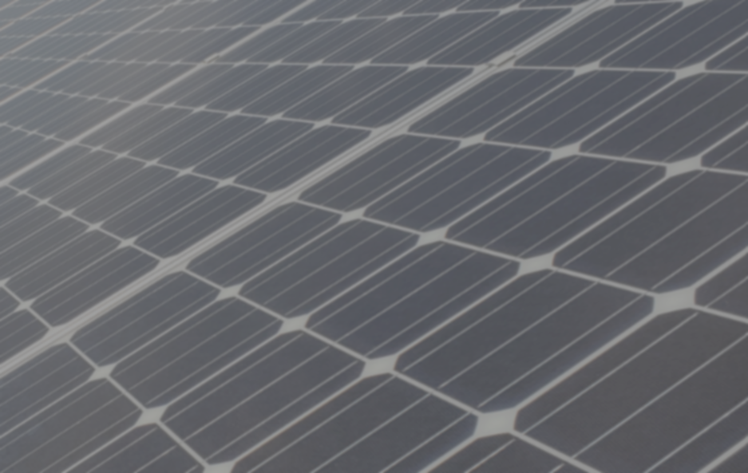
Solar PV System Certification
Effective July 11, 2011, the Maryland Public Service Commission will be receiving applications for certification of tier 1, level 1 and level 2 Solar Renewable Energy Facilities for the Maryland RPS Program through an online “Solar PV Portal.” Paper copies will not be accepted

Slide 3
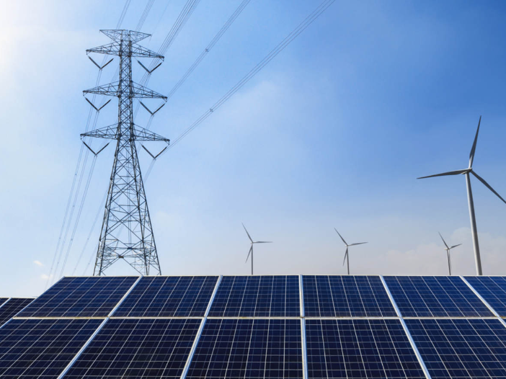
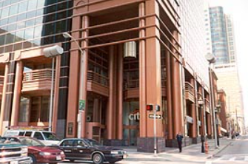
Solar Photovoltaic System Certification Process
Once you have completed the installation of your solar photo voltaic (PV) system, you will need to contact your utility provider (Please see list of utility providers in Maryland on the next slide).
You, the applicant will complete the Interconnection agreement application whereupon a utility interconnection specialist will return a signed and dated Interconnection Agreement Certificate of Completion recognizing the final approval from the utility.
Once you have received your signed copy of the Interconnection Agreement Certificate of Completion, you will then submit an application to the Maryland Public Service Commission to get your solar system certified.
Maryland Public Service Commission

Slide 4
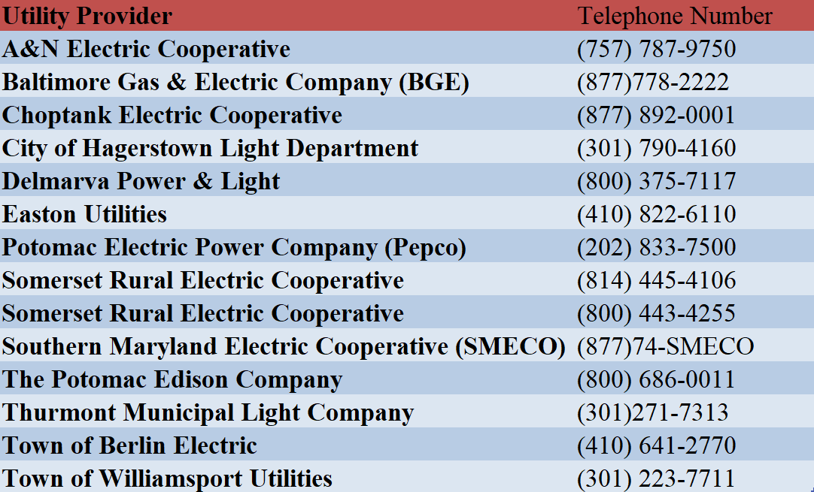

Slide 5
Before Starting the MDPSC Solar Certificate application process, you need to obtain all the required documents for your application selection type (Initial, proposed change/ growth, or decertification)
Generation capacity of 2 MWs and above must submit a CPCN or a CPCN exemption for type 1 and 2 application.
  General Notes: Do not provide as-built drawings, power purchase agreement, billing information, and county permits unless requested.
1
2
3

Slide 6
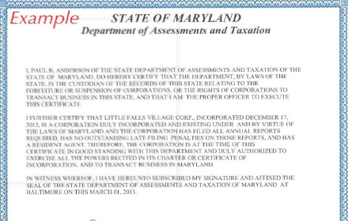
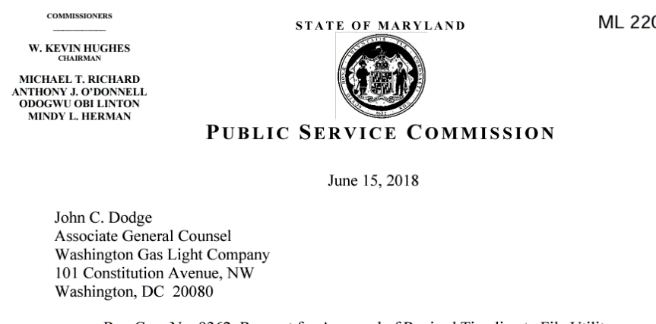
Frequently Asked Questions
How can I obtain an Interconnection Agreement Certificate of Completion?
  Interconnection Agreement Certificate of Completion is provided by your utility provider. In which you will have to fill out and return to the provider to sign.
What is a Certificate of Good Standing and how can I obtain one?
  A certificate provided by the Maryland Department of Assessment and Taxation, which verifies that a business entity is in “good standing,” and all documents and fees required by law to be submitted to the Department have been received, and that no other government agency has notified the Department that the entity is delinquent in tax payments.
    https://dat.maryland.gov/businesses/Pages/Internet-Certificate-of-Status.aspx
What is a letter order?
  This is the certificate that was emailed upon the initial approval of your solar PV system. (Please see sample picture on the bottom right)

Slide 7
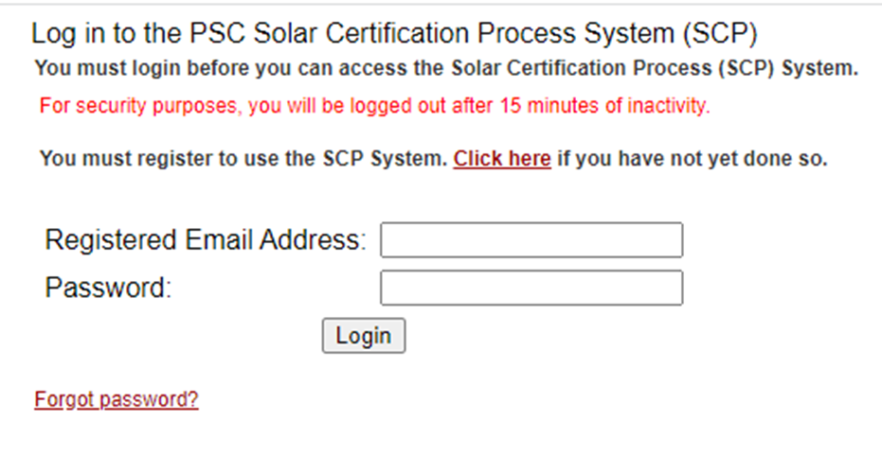
MD PSC Solar Applications are submitted through the PV System https://wowza.psc.state.md.us/newintranet/solarapp/login_new.cfm
Once you have all the required documents for your filing, you will then go to the link above to create a username and password. If you already have a username and password , please log into portal to complete an application

Slide 8
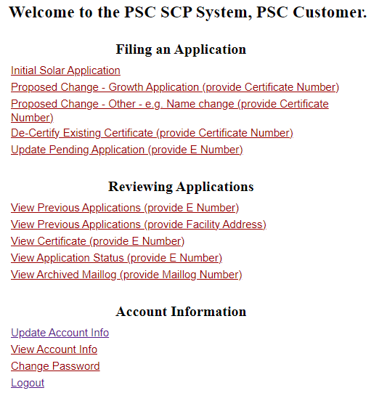
How to Submit an Initial Application
Log on to the portal using the registered email address and password
Scroll down to the bottom of the page to select “I accept”
Select the type of Commission filing
  Initial Solar Application
Complete the entire online application. Information must reflect the information on the Interconnection Agreement Certificate of Completion exactly.
  The facility information on the online application must reflect the Interconnection Agreement Certificate of Completion (IACOC). For example, the facility name on the online application must reflect the name on the customer's name on the IACOC.
Click “Next” to go to the upload page. Once the document(s) are uploaded select “Yes” to Submit Filing.

Slide 9
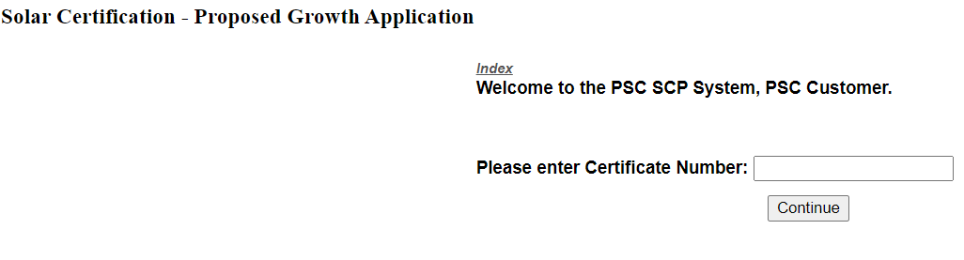
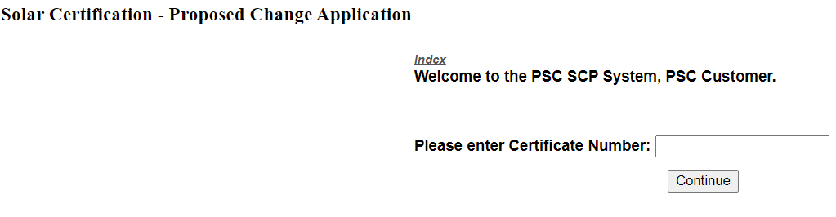
How to Submit a Proposed Growth Application or a Proposed Change Application
Log on to the Portal using the registered email address and password
Read and scroll down to the bottom of the page to select “ I accept”
Select the type of commission filing: Proposed Growth or Proposed Change
  The proposed growth application is only for capacity/ output changes. All other changes must submit a proposed change application.
Type in the MD certification number (example: MD-XXXXX-SUN-01) to start application.
Complete the entire online application. Click next.
The second page is the upload page. On this page you can verify and upload ALL the required documents for the application type. Once the documents are uploaded select “yes” to submit filing.

Slide 10
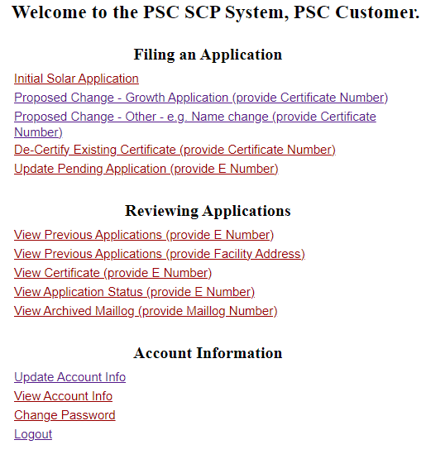
How to Update an Application or Correct a Rejected Application
Log into the portal. Once you are on the main page of the solar application portal, select “Update Pending Application”
Cite the X number (previously E Number) given upon Initial Application submission to make corrections or upload missing documents.
Please refer to any rejection notice received via email for recommended updates to your application.

Slide 11
Most Common Errors
Below are the most common errors that would result to a rejected application and possibly a dismissal of the application:
  Incomplete or Incorrect Interconnection Agreement Certificate of Completion (IACOC). It is the client’s responsibility to complete the IACOC and have it signed by the Utility provider. If the IACOC is incorrect such as the wrong name, city, zip code, etc. it is the client’s responsibility to contact the utility provider and have it corrected.
  The online application is incomplete or does not reflect the Interconnection Agreement Certificate of Completion (IACOC). There are no exceptions. If the name, capacity, or any information does not reflect the IACOC, it will be rejected and if not corrected within a timely matter it will be dismissed. There are no exceptions. If the client does not agree with the information on the IACOC, please contact your utility provider for corrections and submit a letter of explanation. The IACOC must show at least show address, account holder name, system capacity, installer’s information, final acceptance and approval signature with date.
  For the initial application, the solar system should not be energized before the interconnection date. Therefore, the operational date should be on or after the interconnection date on the online application.
If you have any questions related to the application process, please email pvsolarapplication.application@maryland.gov

Slide 12
SREC FAQ
What are Solar Renewable Energy Credits/ Certificates (“SRECS”)?
  SRECs are the commodity traded in markets in states that have Renewable Portfolio Standards (RPS) programs.
  A REC is created for every megawatt-hour of electricity generated. Anyone who registers a generator with Maryland Public Service Commission and registers an account with PJM, can sell RECs.
Where do I get solar renewable energy credits from?
  PJM Interconnection is the power grid operator and wholesale market administrator for Maryland. PJM Generation Attribute Tracking System (GATS) is a multi-state registry for SRECs (please see GATS website for more information). It was designed to help the needs of buyers and sellers.
What is an aggregator?
  An aggregator trades various renewable energy sources or manage these sources on owners’ behalf.
Could I obtain SRECs on my own?
  Yes! First you would have to certify your solar photovoltaic system with the Public Service Commission. If approved, you will receive a certification number. Upon receipt of the certification number, you would go to GATS PJM and follow their procedures for registration. https://www.pjm-eis.com/getting-started

Slide 13
How do I Trade SREC?
The Maryland Public Service Commission is not involved in SREC trading. Please reach out to the following option for inquiry on trading.
PJM-EIS' Generation Attribute Tracking System (GATS) is a trading platform for solar renewable credits. Please contact them directly for Solar Renewable Energy Credits. Prior to registering with PJM GATS, you would first need a certification number from the Public Service Commission.
  Website: https://www.pjm-eis.com/getting-started
  Email: gatsadmin@pjm-eis.com
  Telephone: (877) 750-GATS (4287)

Slide 14
Contact Information
The Maryland Public Service Commission is responsible for the certification of solar photovoltaic systems. Please contact the following if you need help in:
Certification/ application process questions:
  pvsolarapplication.application@maryland.gov
Interconnection Agreement Certificate of Completion:
  Contact your utility provider, see slide 4.
Renewable portfolio standard compliance questions:
  craig.taborsky@maryland.gov
  christine.ugwa@maryland.gov
Public Service Commission engineering questions:
  craig.taborsky@maryland.gov

